Slide 1

Why multitasking is in fact ineffective
Wojciech Krakowiak

Slide 2

What really is multitasking?
Fractioning your attention into little bits (by dividing resources of your brain)
Not engaging in anything fully rather than processing everything at once
What we think about when talking about multitasking is rapid switching between stimuli (continuous partial attention)

Slide 3
Why do we try to multitask?
Many “time wasters” that make us feel like we’re very busy and won’t meet the deadline
World that can’t slow down, and keeps us under the impression that we can’t either

Slide 4
Multitasking is a lie
Things that need focus will remain undone unless we stop multitasking
Brain uses up all it’s neurotransmitters for many different things
In effect none are left to complete anything particular

Slide 5
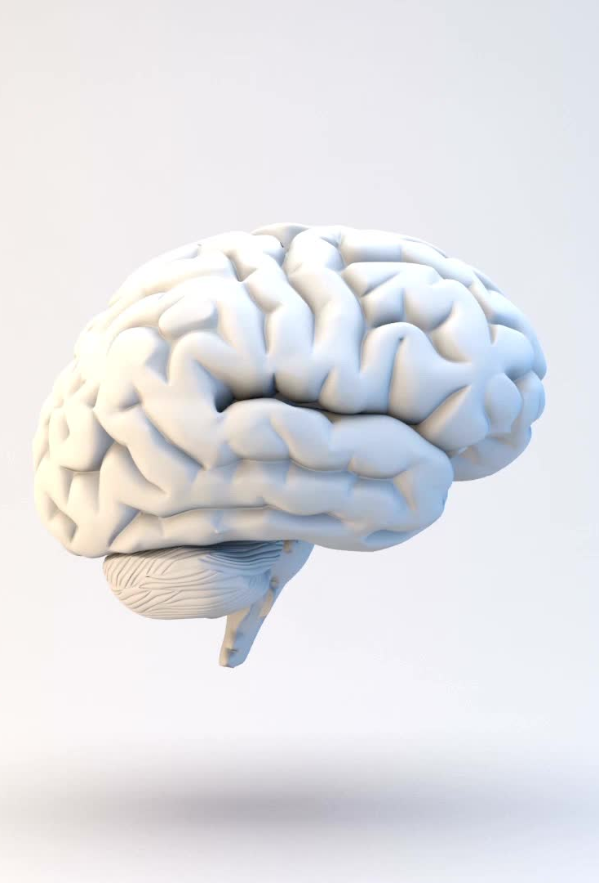
Strategies to focus on one thing at a time
It takes 20,000 years to evolve our brain
Taking a break can help
We are not slaves of stimuli around us

Slide 6

Thank you for your attention

